Slide 1
Quantum Hardware I
Binhan Hua

Slide 2
How close are we to a working quantum computer?
A: by the end of 2022
B: by the end of 2030
C: by the end of 2050
D: how the hell do I know
Notes:
Start with a joke: I studied quantum computing for a year and started doing research. One day during a facetime my dad started asking me all kinds of questions about where to buy a quantum computer and if I can get a discount. I was genuinely confused as to where that was coming from, and he told me some guy on twitter claims that we’re gonna have a silicon based quantum computing by the end of the year. Jokes on that guy I actually read the Australian paper about this and it’s not even close.

Slide 3
Introduction to Quantum Hardware
What are we looking for?
What are some physical requirements for a qubit?
What are some desirable traits for these qubits?
Notes:
Motivate implementing qubits
What are we looking for? Qubits
What are some physical requirements for a qubit? Small, stable, controllable…
What are some desirable traits of these qubits? Low noise, low error…

Slide 4
DiVincenzo’s Criteria
A scalable physical system with well-characterized qubit
The ability to initialize the state of the qubits to a simple fiducial state
Long relevant decoherence times
A “universal” set of quantum gates
A qubit-specific measurement capability
Notes:
Introduce DiVincenzo’s criteria. Explain why each of them is important.

Slide 5
What kind of quantum hardware are out there?
Superconducting qubits (IBM, Google)
Diamond color centers
Trapped Ions (IonQ)
Quantum Dots
Neutral atom arrays
Notes:
Stop for questions before going into the topic

Slide 6
Superconducting Qubits

Slide 7
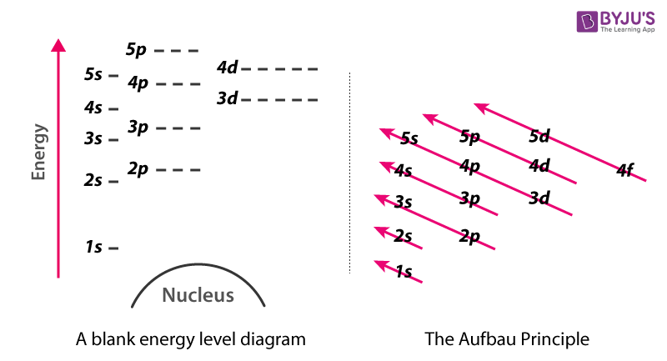
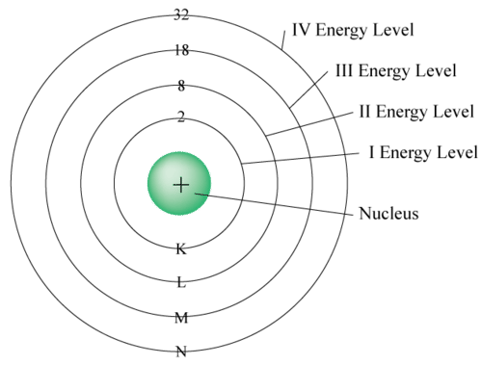
Review of energy levels
Notes:
This is related to the introductory materials. During the introduction to quantum mechanics, we need to make sure that people understand what energy levels are, and how they are inherent in a lot of things.
We need to also relate energy states to the state 0 and 1.

Slide 8
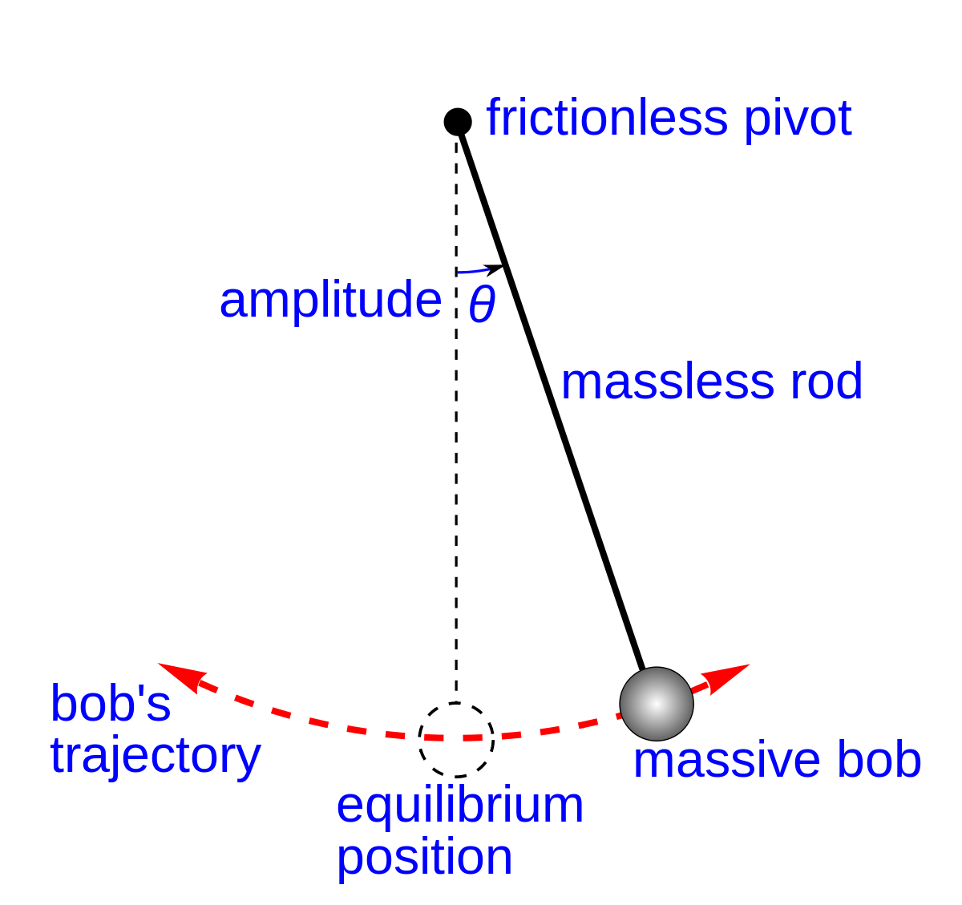
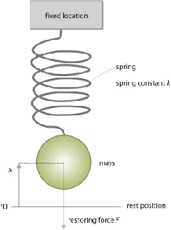
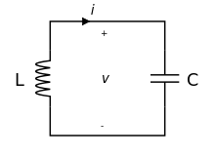
Harmonic Oscillator
Notes:
Introduce the joke that physicists only know how to solve one thing and that’s harmonic oscillator.
Why do we want to use this? We can create something that we can control. We can tune our energy levels.

Slide 9
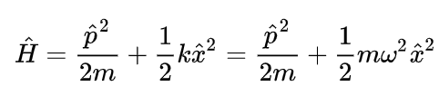
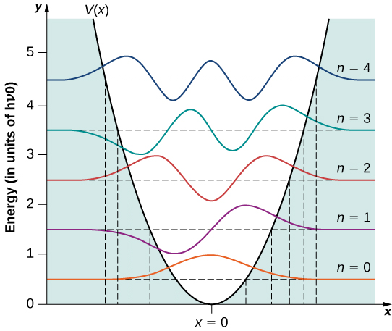
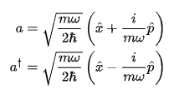


Quantum Harmonic Oscillator
Notes:
Briefly touch on the math. I’m not sure if we are going to cover this during our introduction to quantum mechanics, so this will either be a review or a brand new idea. I am ready to talk about it if necessary, but we can also gloss over the details and focus on the part about equal spacing.

Slide 10
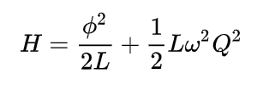
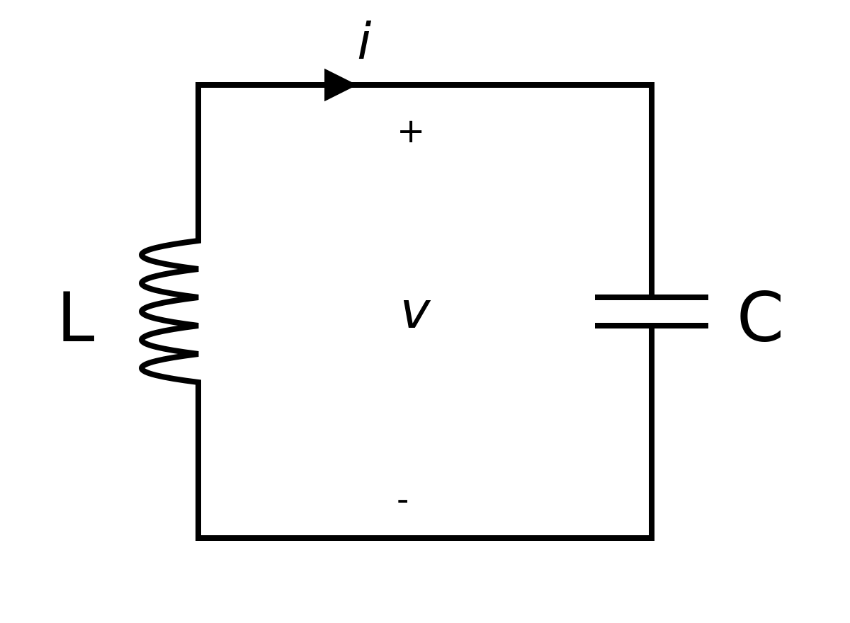
Quantum LC Circuit
The Hamiltonian we are working with
Notes:
Show the similarity of LC circuits to harmonic oscillators

Slide 11
QUBIT
Notes:
And we have our qubit! Actually not so fast. Any issues with the qubit?

Slide 12
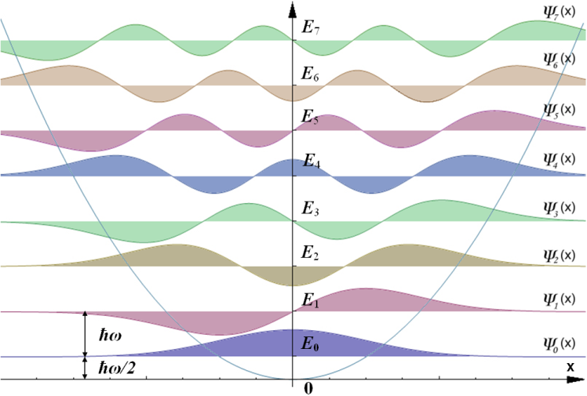
Issues with a harmonic oscillator
How do we control a qubit?
Microwave pulses are used to “excite” the qubit from one energy level to the other
What if we keep exciting the same harmonic oscillator?
Notes:
Talk about qubit leakage

Slide 13
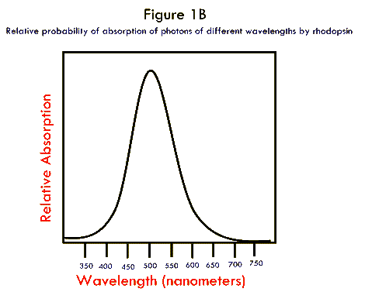
FACT: things in nature are picky
Notes:
Talk about absorption curve. Atoms, ions, and a lot of stuff does this.

Slide 14


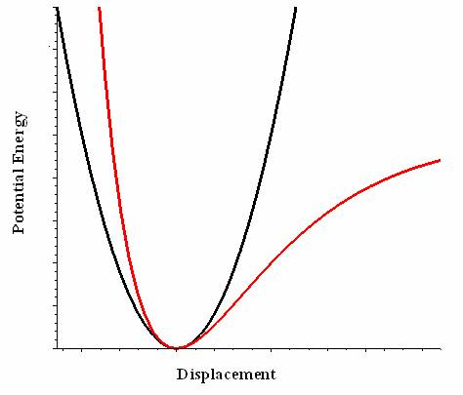
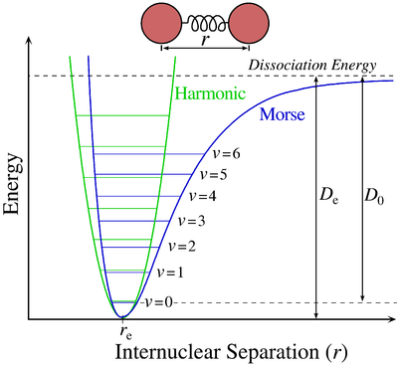
An-harmonic oscillator
Notes:
Isolating the first two energy levels

Slide 15
How do we do that?
First, let’s backtrack a little and look at another problem
Our world is not perfect, so we are stuck with things like friction forces
Electronic components are the same: we have resistance…
Notes:
Talk about why we’re using superconducting materials
Last line: we have resistance… but what if we don’t?

Slide 16
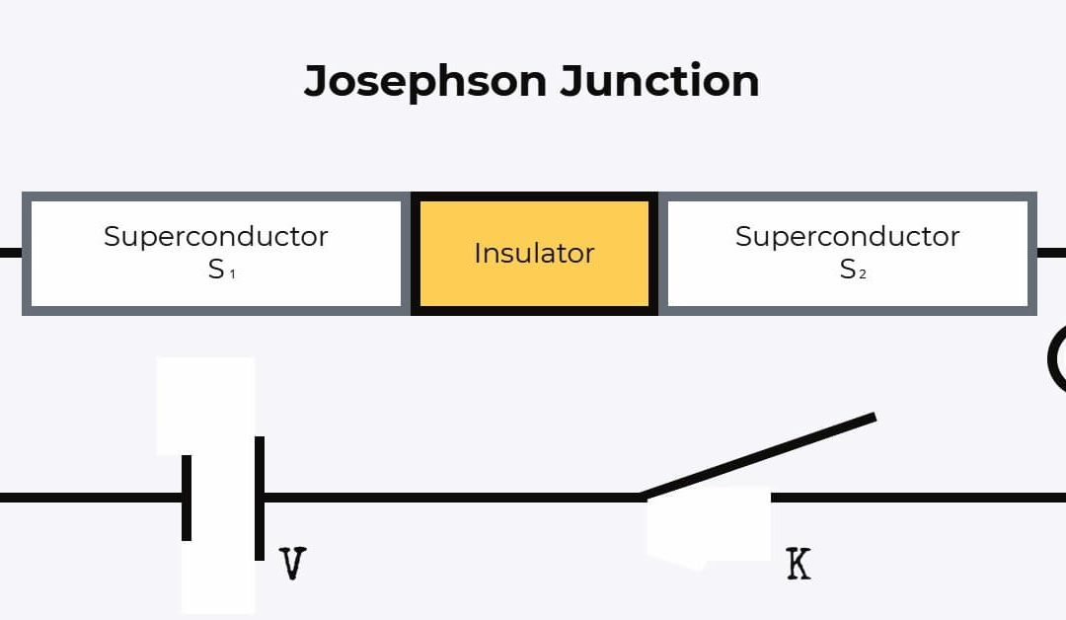
Superconducting circuit and Josephson Junction
Notes:
Explain how this component function as the non-linearity and anharmonicity part

Slide 17
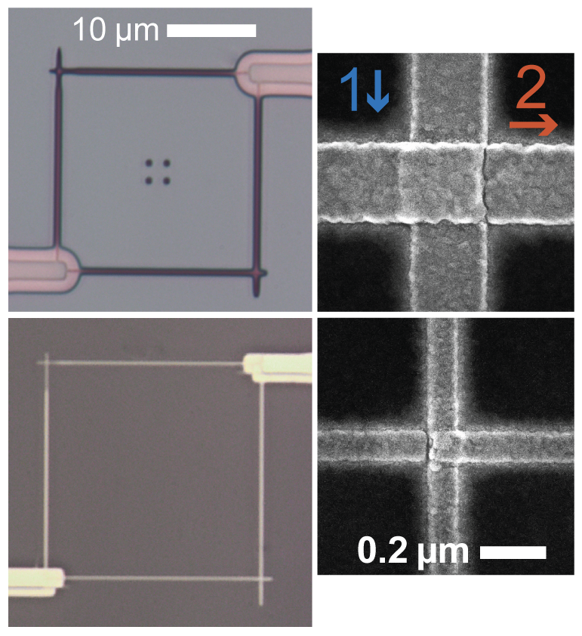
Josephson Junction Fabrication
Nano labs are a truly magnificent place to exist… and let’s just admire that for a little
Notes:
Stop for questions before going into real life stuff

Slide 18
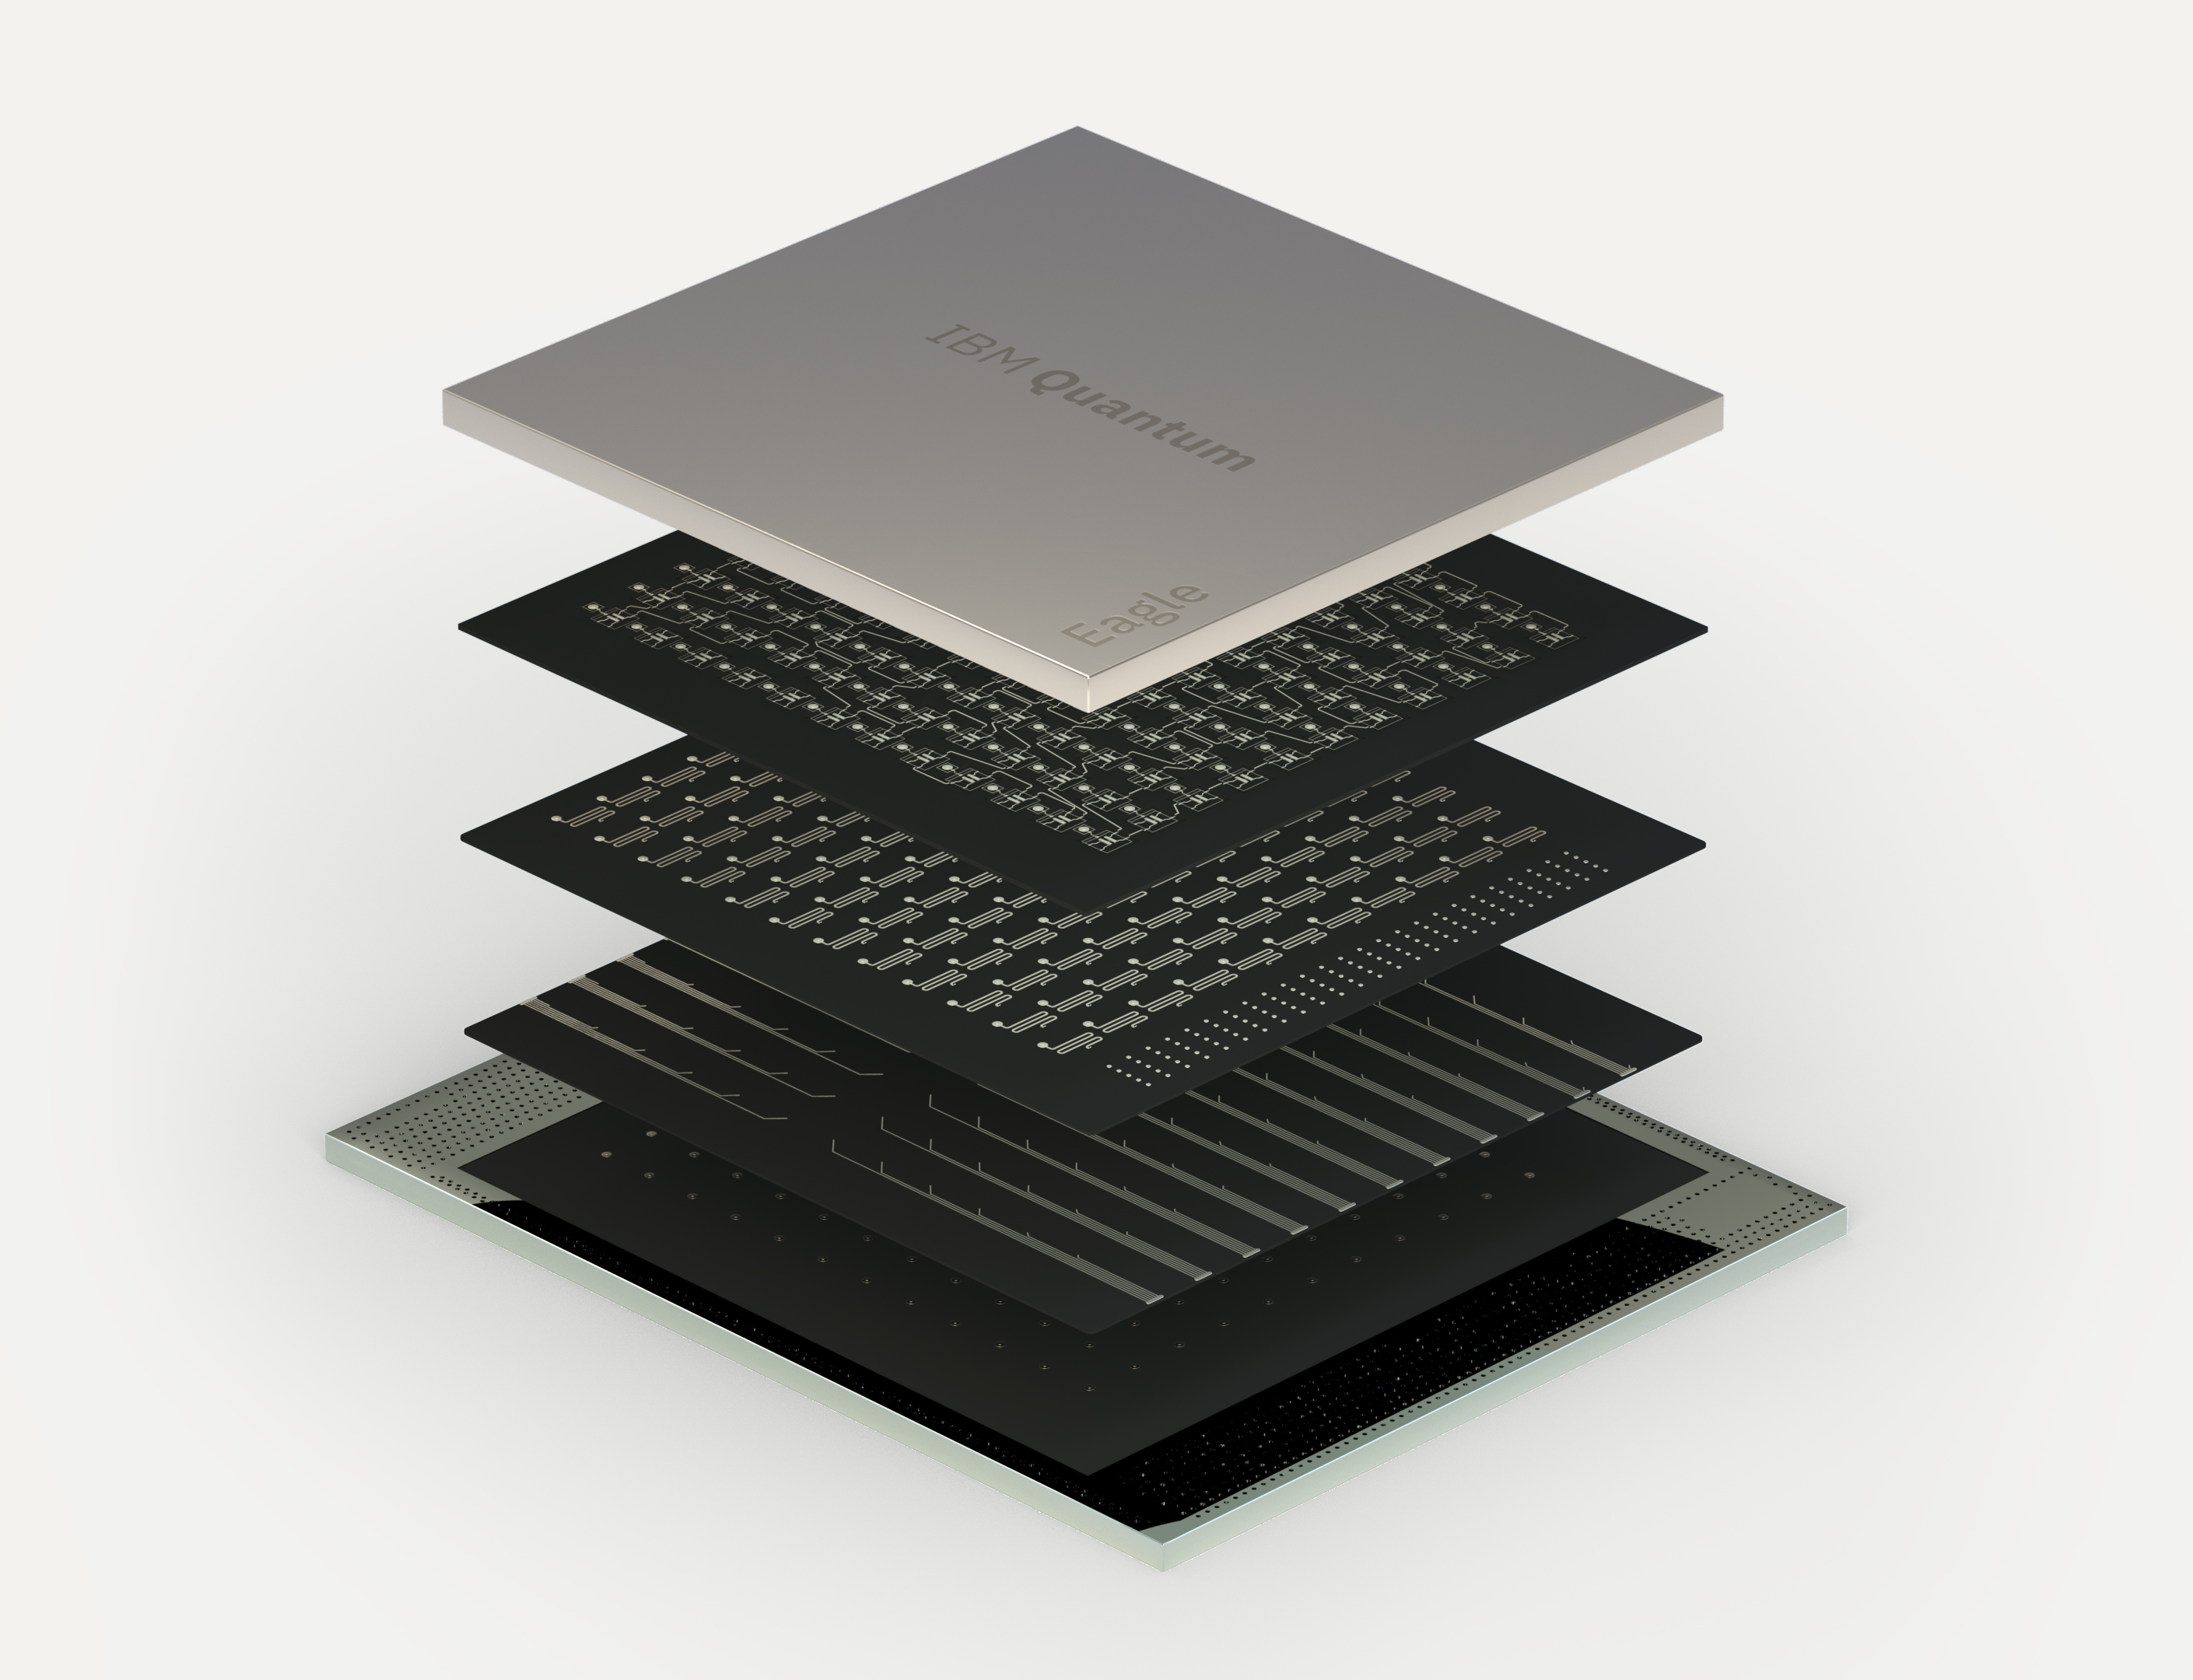
How they do it in real life
IBM is so far the biggest superconducting qubit company

Slide 19
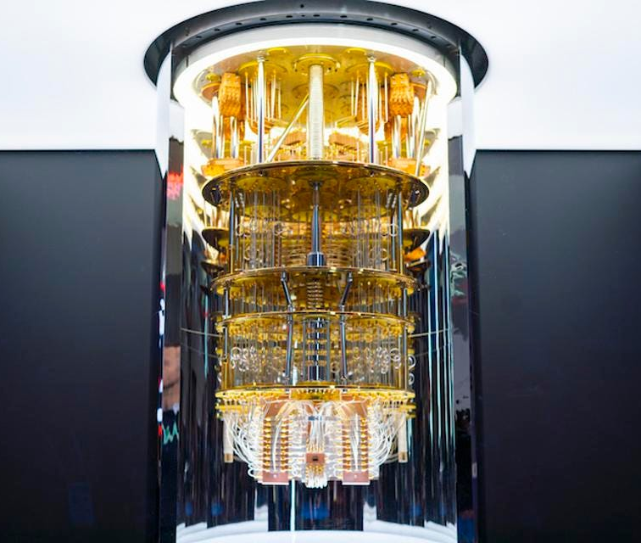
What are we even looking at…

Slide 20
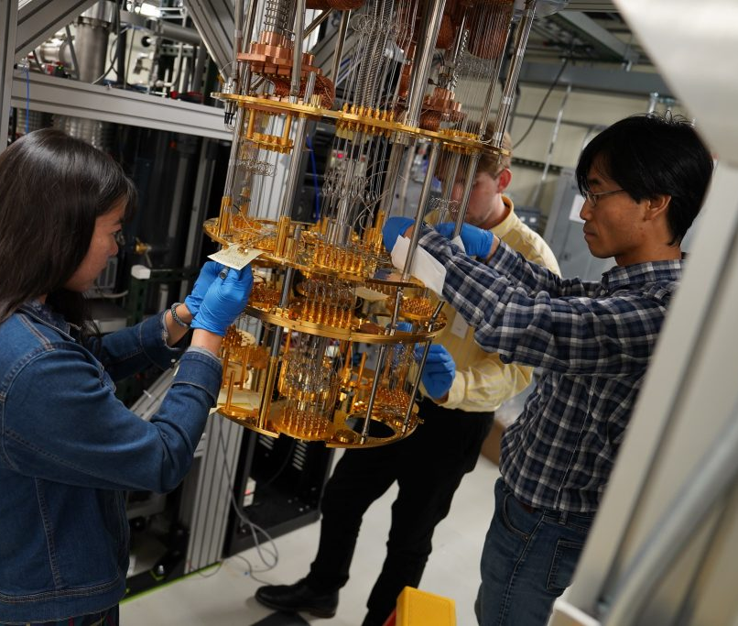
What are we even looking at…
Notes:
Explain what a dilution fridge is

Slide 21
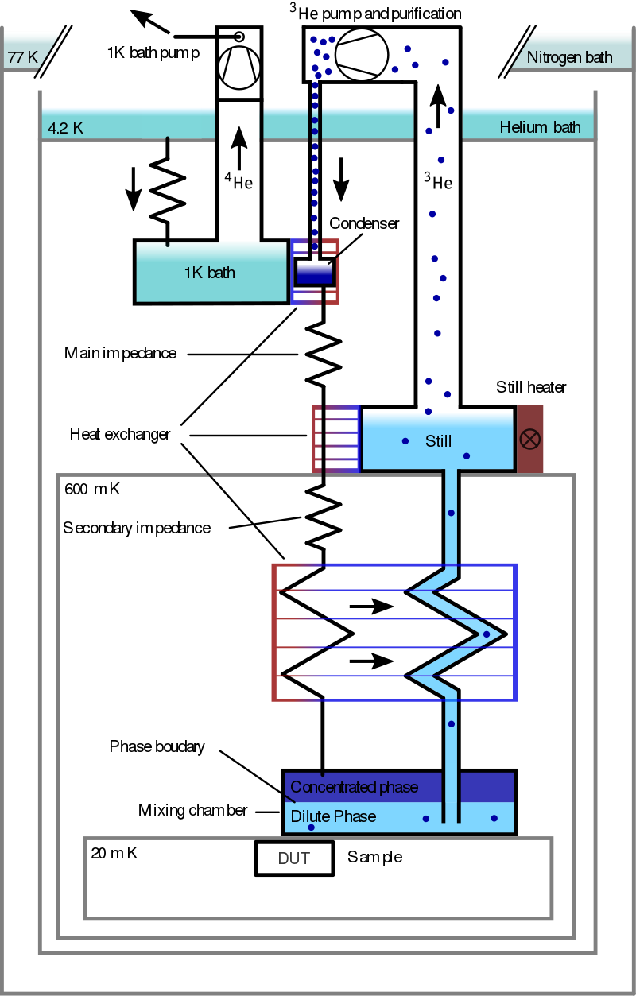
Dilution Fridge
Yeah man it’s a fridge…
Silicon becomes superconducting at 0.35K
We have less thermal fluctuations at 20mK

Slide 22
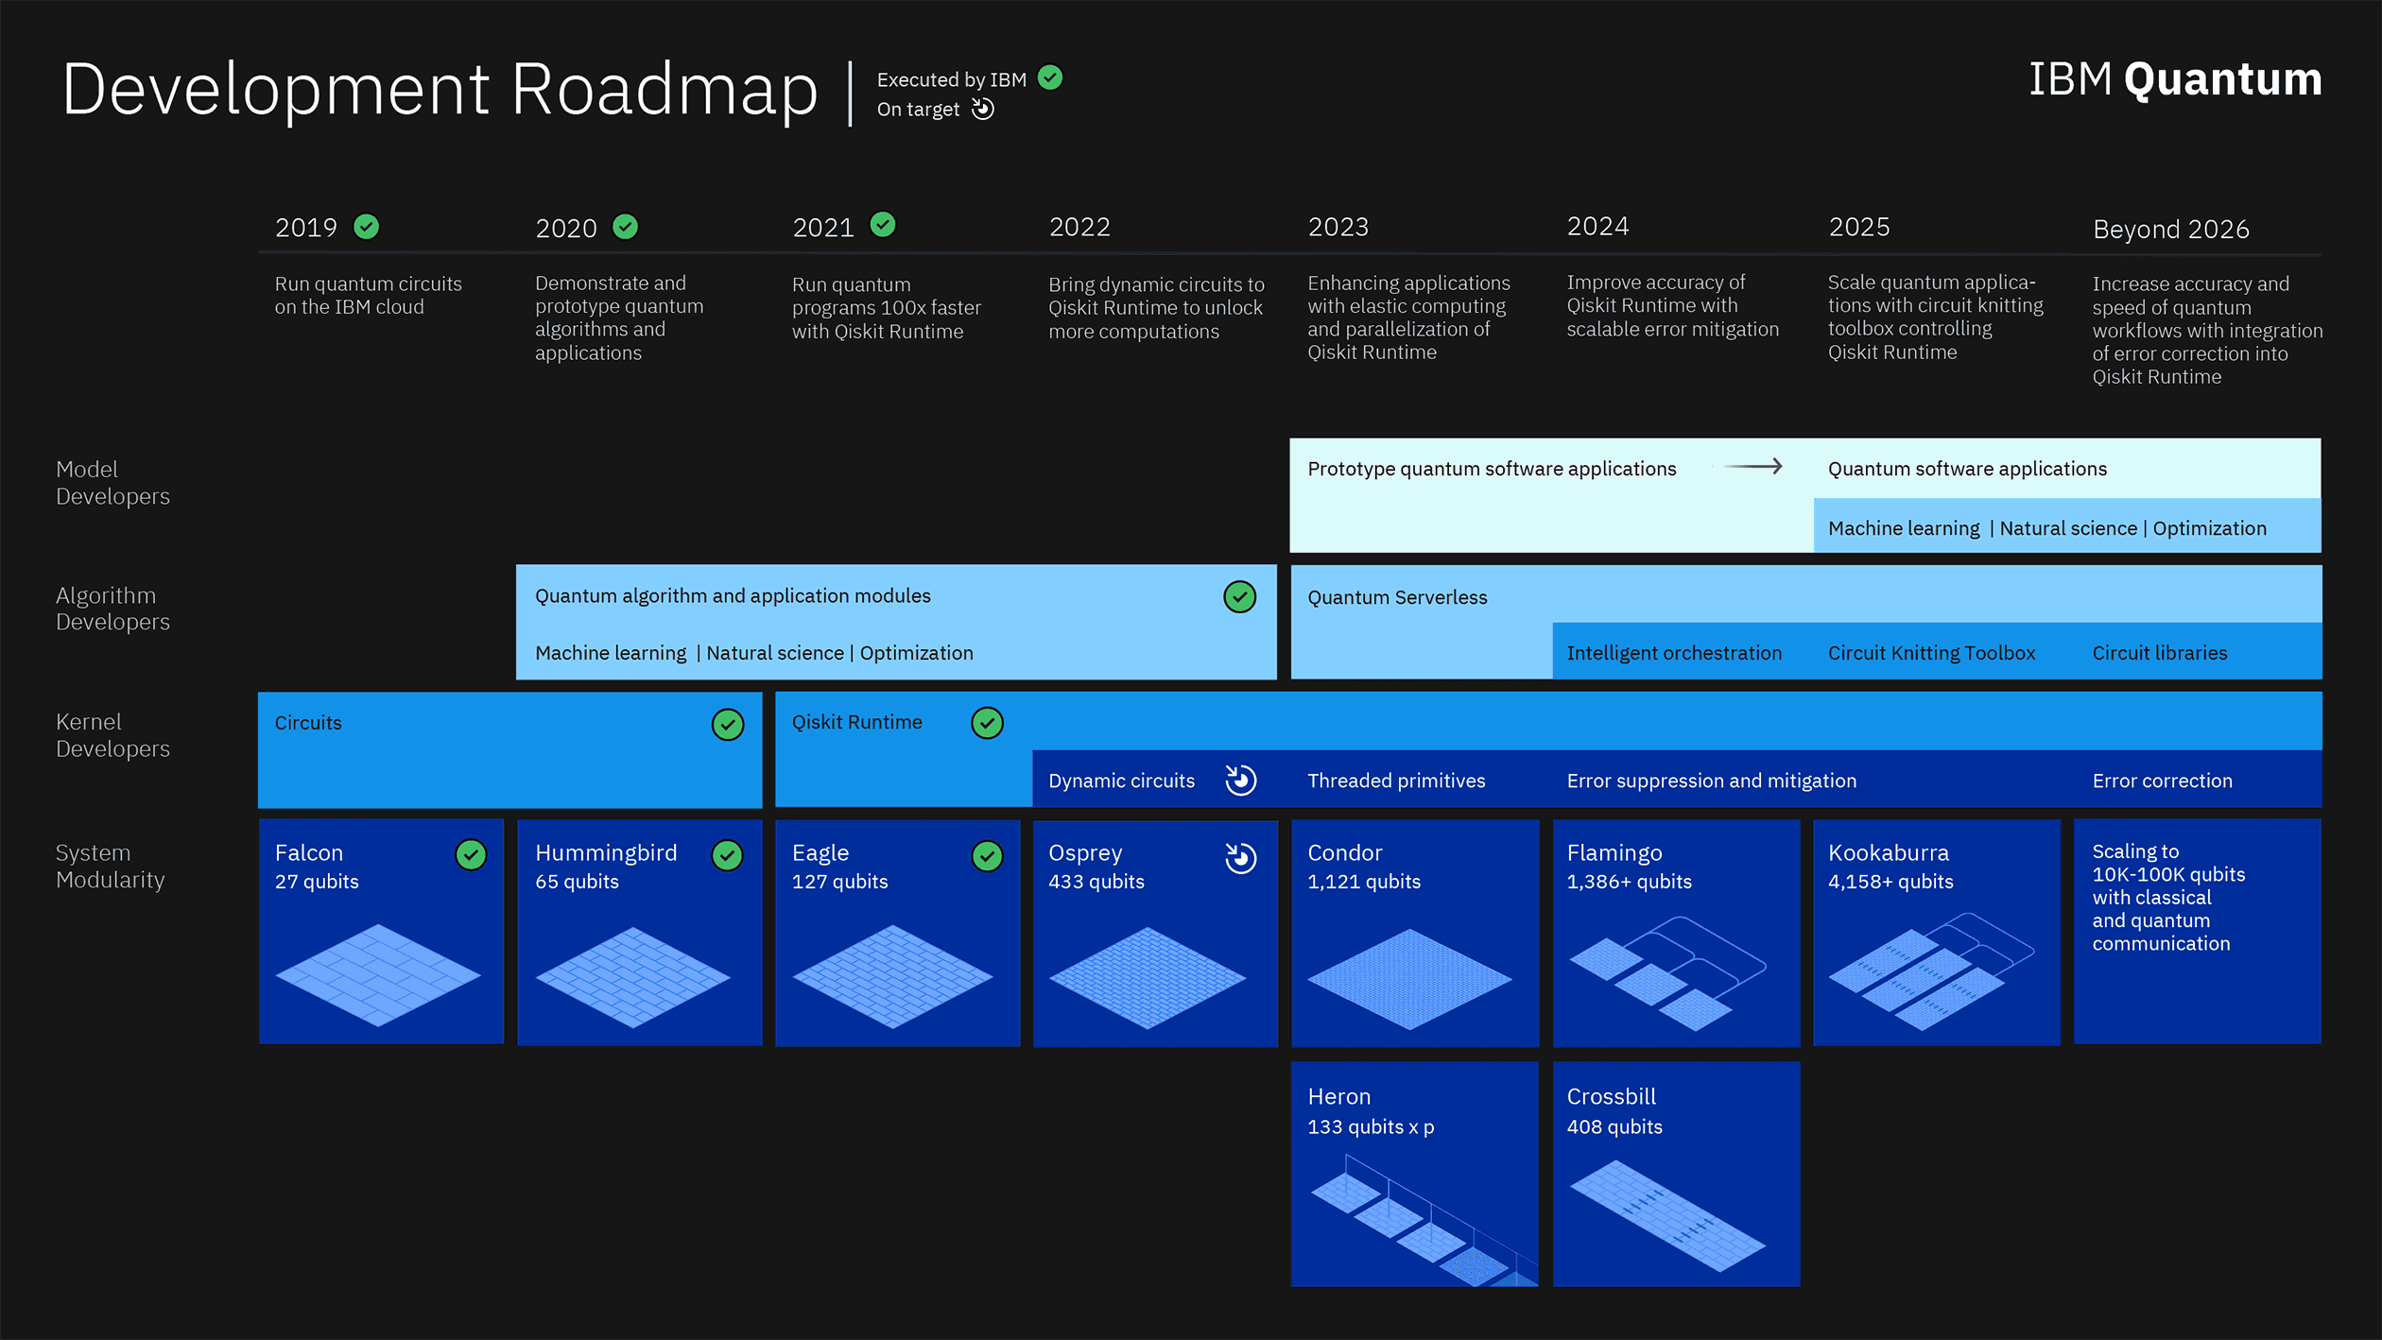

Slide 23
Things I have glossed over
Qubit control
Single qubit gates are usually implemented using microwave pulses
Double qubit gates (CNOT) are achieved by coupling two qubits to the same microwave cavity
Qubit readout
Done by coupling (usually capacitively) to a qubit readout bus or line
Josephson Junction
Josephson effect creates something called a supercurrent
Decoherence time
50 micro second, but that’s fine since operations are quick too

Slide 24
Conclusion
Physicists only know how to solve one thing and that is disgusting
Hey we have a harmonic oscillator! That’s pretty much a qubit.
Hey we have an anharmonic oscillator! That’s a qubit!
We have a fancy fridge to make things superconducting
My dad’s not getting his student discounted quantum computer as Christmas present this year

Slide 25
Questions?

